Slide 1
Nonlinear Equations I
Week 2
Example of mathematical modeling
Solving the roots
Dr. Michael R. Gustafson II, Duke University
All images copyright © The McGraw-Hill Companies, Inc. Permission required for reproduction or display.
Numerical Methods for Engineers and Scientists: An Introduction with Applications Using MATLAB by Amos Gilat and Vish Subramaniam.

Slide 2
Example of Mathematical Modeling
Week 2 part I

Slide 3
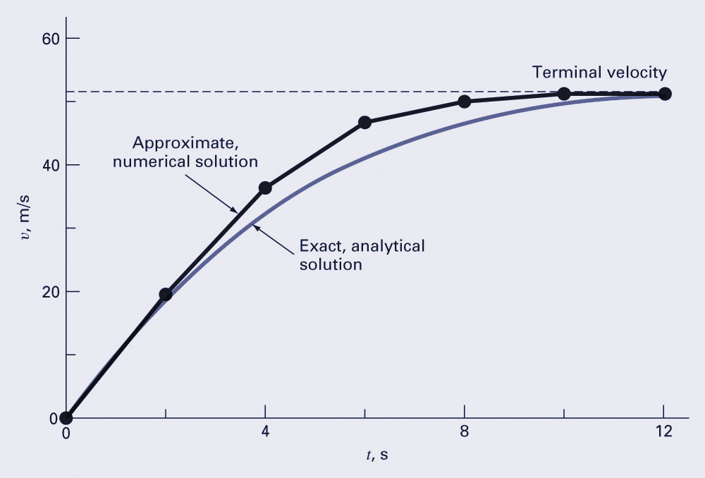
Numerical Results
How do we improve the solution?

Slide 4
Solving The Roots
Week 2 part II
Why do we need to solve the roots?
Please think about it and I may ask you next Monday.

Slide 5
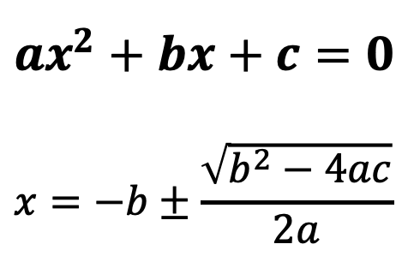
Solve Equations
$$ax^{2}+bx+c=0$$
$$x=−b±\frac{\sqrt{b^{2}−4ac}}{2a}$$

Slide 6

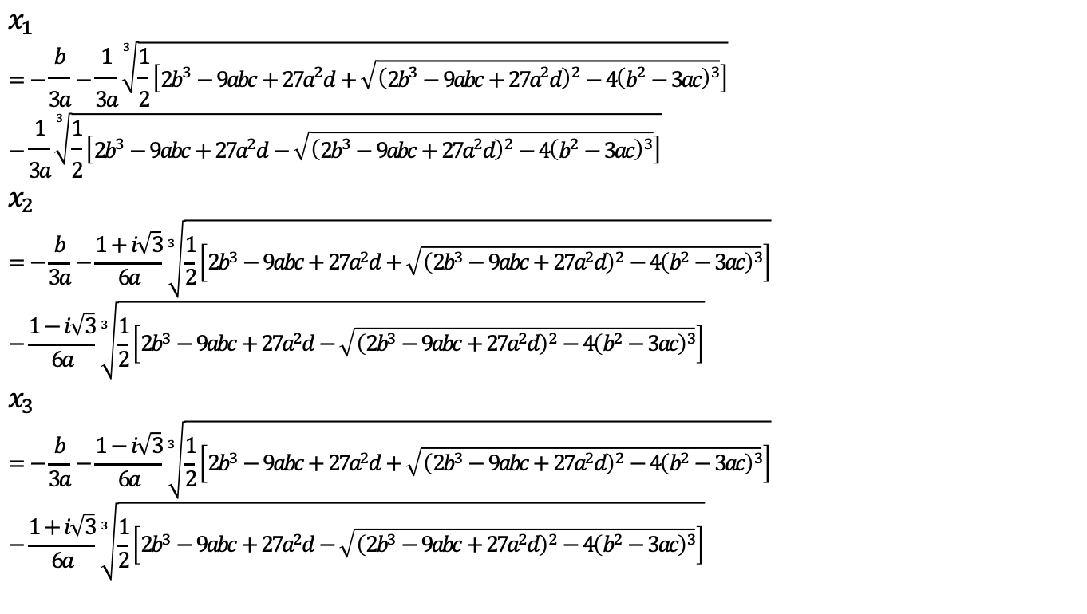
Cubic Equation
$$ax^{3}+bx^{2}+cx+d=0$$
$$x_{1}=−\frac{b}{3a}−\frac{1}{3a}\sqrt[3]{\frac{1}{2}\left[2b^{3}−9abc+27a^{2}d+\sqrt{{\left(2b^{3}−9abc+27a^{2}d\right)}^{2}−4{\left(b^{2}−3ac\right)}^{3}}\right]}−\frac{1}{3a}\sqrt[3]{\frac{1}{2}\left[2b^{3}−9abc+27a^{2}d−\sqrt{{\left(2b^{3}−9abc+27a^{2}d\right)}^{2}−4{\left(b^{2}−3ac\right)}^{3}}\right]}$$
$$x_{2} \\ =−\frac{b}{3a}−\frac{1+i\sqrt{3}}{6a}\sqrt[3]{\frac{1}{2}\left[2b^{3}−9abc+27a^{2}d+\sqrt{{\left(2b^{3}−9abc+27a^{2}d\right)}^{2}−4{\left(b^{2}−3ac\right)}^{3}}\right]}−\frac{1−i\sqrt{3}}{6a}\sqrt[3]{\frac{1}{2}\left[2b^{3}−9abc+27a^{2}d−\sqrt{{\left(2b^{3}−9abc+27a^{2}d\right)}^{2}−4{\left(b^{2}−3ac\right)}^{3}}\right]}$$
$$x_{3} \\ =−\frac{b}{3a}−\frac{1−i\sqrt{3}}{6a}\sqrt[3]{\frac{1}{2}\left[2b^{3}−9abc+27a^{2}d+\sqrt{{\left(2b^{3}−9abc+27a^{2}d\right)}^{2}−4{\left(b^{2}−3ac\right)}^{3}}\right]}−\frac{1+i\sqrt{3}}{6a}\sqrt[3]{\frac{1}{2}\left[2b^{3}−9abc+27a^{2}d−\sqrt{{\left(2b^{3}−9abc+27a^{2}d\right)}^{2}−4{\left(b^{2}−3ac\right)}^{3}}\right]}$$

Slide 7
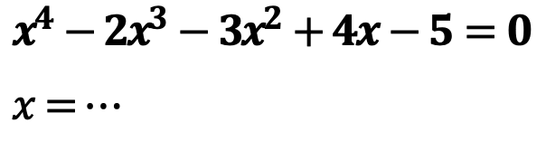
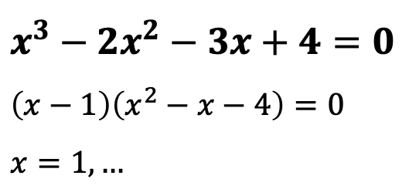
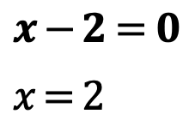
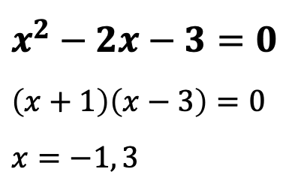
Solve Equations
$$x−2=0$$
$$x=2$$
$$x^{3}−2x^{2}−3x+4=0$$
$$\left(x−1\right)\left(x^{2}−x−4\right)=0$$
$$x=1,…$$
$$x^{2}−2x−3=0$$
$$\left(x+1\right)\left(x−3\right)=0$$
$$x=−1, 3$$
$${x^{4}−2x}^{3}−3x^{2}+4x−5=0$$
$$x=…$$

Slide 8
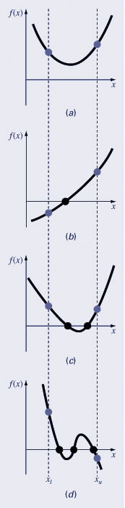
Graphical Methods
A simple method for obtaining the estimate of the root of the equation f(x)=0 is to make a plot of the function and observe where it crosses the x-axis.
Graphing the function can also indicate where roots may be and where some root-finding methods may fail:
Same sign, no roots
c) Different sign, one root
b) Same sign, two roots
d) Different sign, three roots

Slide 9
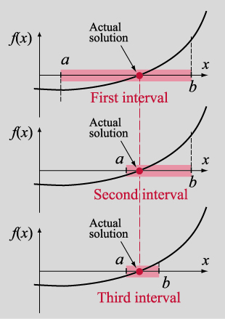
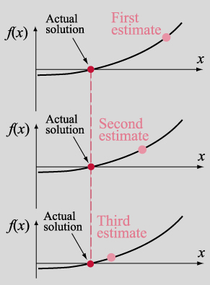
Numerical Methods for Solving The Roots
(a) Bracketing method
(b) Open method

Slide 10
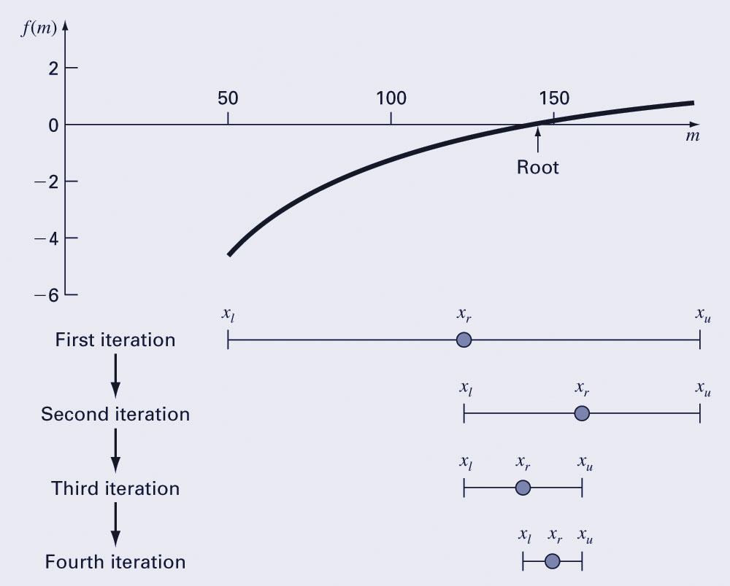
Bisection Method (Bracketing method)
The bisection method is a variation of the incremental search method in which the interval is always divided in half.
If a function changes sign over an interval, the function value at the midpoint is evaluated.
The location of the root is then determined as lying within the subinterval where the sign change occurs.
The absolute error is reduced by a factor of 2 for each iteration.

Slide 11
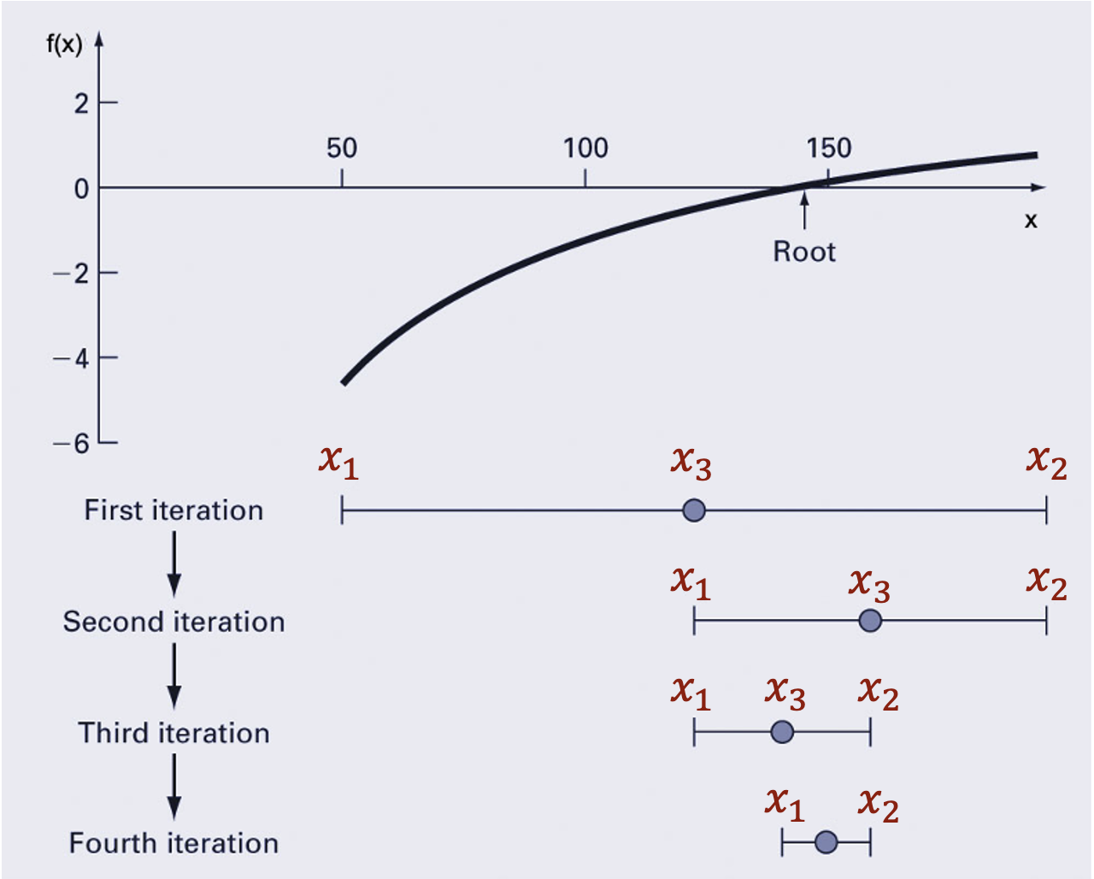

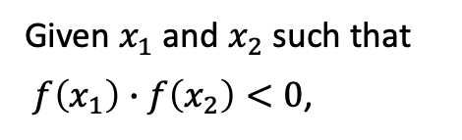
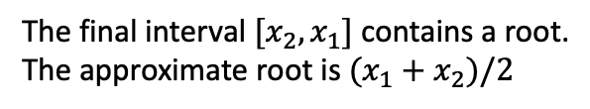

Algorithm of the Bisection Method
Given $x_{1}$ and $x_{2}$ such that
$f\left(x_{1}\right)∙f\left(x_{2}\right)<0$,
Repeat
Set $x_{3}=\frac{1}{2}\left(x_{1}+x_{2}\right)$
If $f\left(x_{1}\right)∙f\left(x_{3}\right)<0$
Set $x_{2}=x_{3}$
Else
Set $x_{1}=x_{3}$
End if
Until ${(x}_{2}−x_{1})<TOL$
How to stop the process?
Stopping criteria?
Tolerance: how to close to the true solutions?
The final interval $[x_{2}, x_{1}]$ contains a root.
The approximate root is $(x_{1}+x_{2})/2$

Slide 12
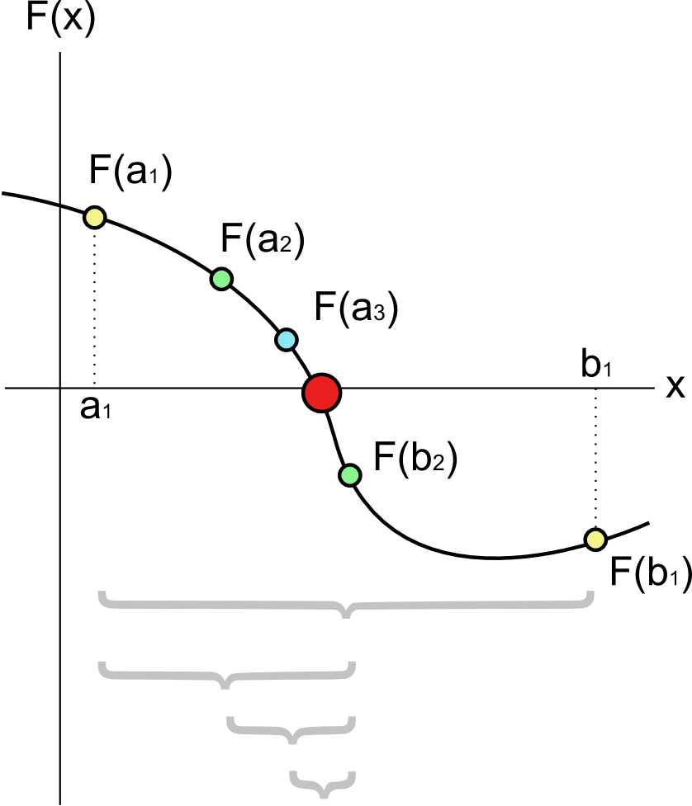
Each step, or each function evaluation, cuts of the uncertainty of the root in the bisection method by a factor of two.
from wiki

